Slide 1
Fractions and Decimals
Math Lesson 2

Slide 2
Schedule
Icebreaker: What do you know about fractions in relation to decimals?
Watch: Common Fractions and Decimals
Practice: Write Common Decimals as Fractions
Practice: Write Common Fractions as Decimals
Break: 5 minutes!
Worksheet: Common Fractions and Decimals
Checkout: How do you feel about common fractions and decimals?

Slide 3
Icebreaker
What do you know about fractions in relation to decimals?
How do you feel about adding fractions?

Slide 4



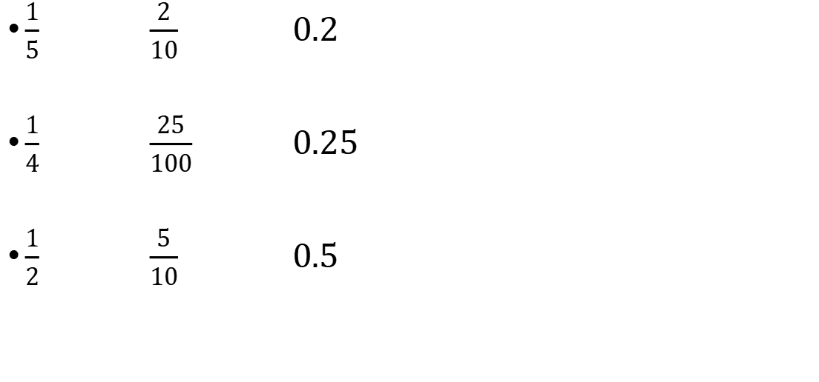
Common Fractions and Decimals
$\frac{1}{5}$ $\frac{2}{10}$ 0.2
$\frac{1}{4}$ $\frac{25}{100}$ 0.25
$\frac{1}{2}$ $\frac{5}{10}$ 0.5
$$×2$$
$$÷2$$
$$×25$$
$$÷25$$
$$×5$$
$$÷5$$

Slide 5
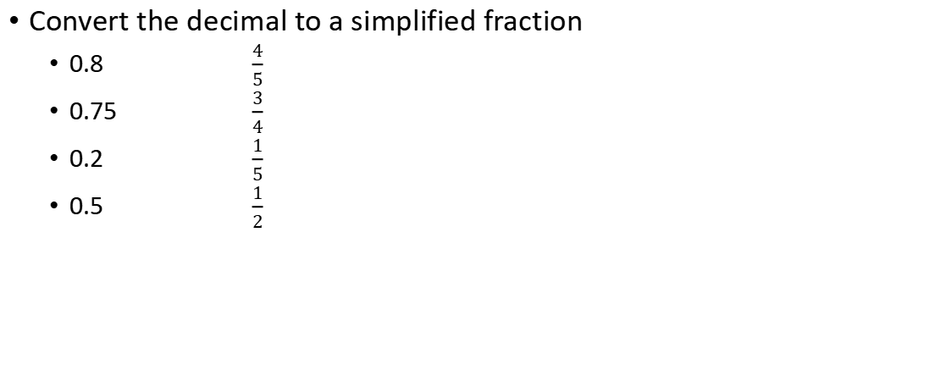
Practice: Write Common Decimals as Fractions
Convert the decimal to a simplified fraction
  0.8 $\frac{4}{5}$
  0.75 $\frac{3}{4}$
  0.2 $\frac{1}{5}$
  0.5 $\frac{1}{2}$

Slide 6
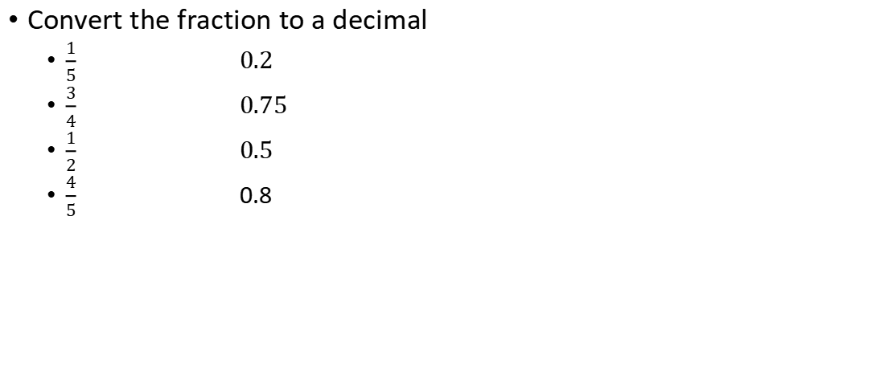
Practice: Write Common Fractions as Decimals
Convert the fraction to a decimal
  $\frac{1}{5}$ 0.2
  $\frac{3}{4}$ 0.75
  $\frac{1}{2}$ 0.5
  $\frac{4}{5}$ 0.8

Slide 7
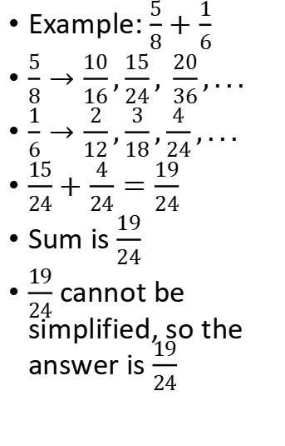
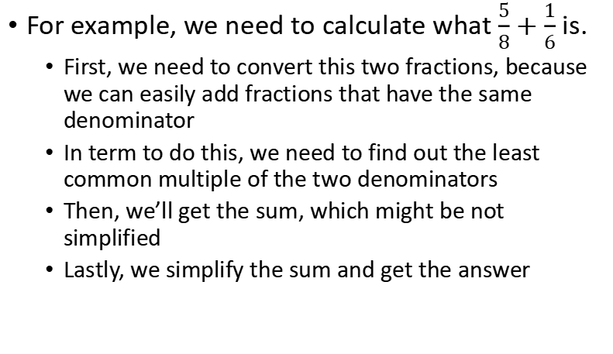
Adding fractionswith unlike denominators
For example, we need to calculate what $\frac{5}{8}+\frac{1}{6}$ is.
  First, we need to convert this two fractions, because we can easily add fractions that have the same denominator
  In term to do this, we need to find out the least common multiple of the two denominators
  Then, we’ll get the sum, which might be not simplified
  Lastly, we simplify the sum and get the answer
Example: $\frac{5}{8}+\frac{1}{6}$
$\frac{5}{8}→\frac{10}{16},\frac{15}{24}, \frac{20}{36},...$
$\frac{1}{6}→\frac{2}{12},\frac{3}{18},\frac{4}{24},...$
$\frac{15}{24}+\frac{4}{24}=\frac{19}{24}$
Sum is $\frac{19}{24}$
$\frac{19}{24}$ cannot be simplified, so the answer is $\frac{19}{24}$

Slide 8
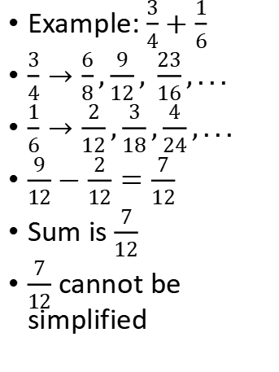
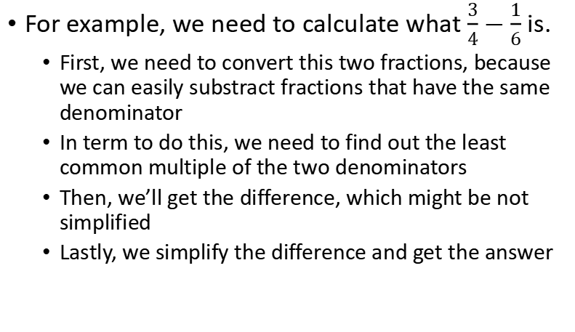
Subtracting fractionswith unlike denominators
For example, we need to calculate what $\frac{3}{4}−\frac{1}{6}$ is.
  First, we need to convert this two fractions, because we can easily substract fractions that have the same denominator
  In term to do this, we need to find out the least common multiple of the two denominators
  Then, we’ll get the difference, which might be not simplified
  Lastly, we simplify the difference and get the answer
Example: $\frac{3}{4}+\frac{1}{6}$
$\frac{3}{4}→\frac{6}{8},\frac{9}{12}, \frac{23}{16},...$
$\frac{1}{6}→\frac{2}{12},\frac{3}{18},\frac{4}{24},...$
$\frac{9}{12}−\frac{2}{12}=\frac{7}{12}$
Sum is $\frac{7}{12}$
$\frac{7}{12}$ cannot be simplified

Slide 9
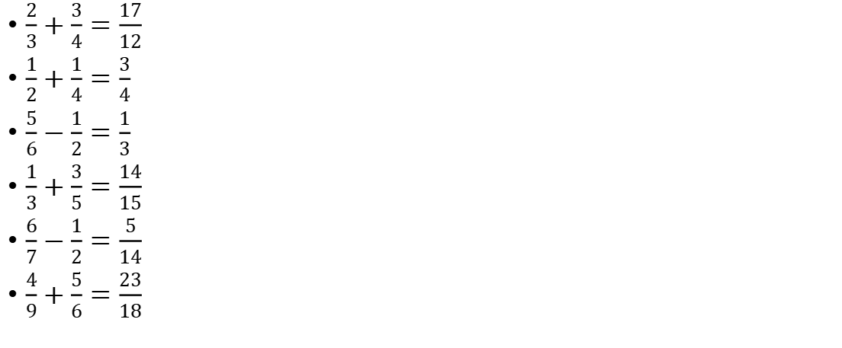
Practice - Adding/subtracting fractions
$\frac{2}{3}+\frac{3}{4}=\frac{17}{12}$
$\frac{1}{2}+\frac{1}{4}=\frac{3}{4}$
$\frac{5}{6}−\frac{1}{2}=\frac{1}{3}$
$\frac{1}{3}+\frac{3}{5}=\frac{14}{15}$
$\frac{6}{7}−\frac{1}{2}=\frac{5}{14}$
$\frac{4}{9}+\frac{5}{6}=\frac{23}{18}$

Slide 10
Break Time:)
We’ll be back at 5.50PM

Slide 11
Kahoot Time ^_^
Game PIN: 07081708
Link: https://kahoot.it/challenge/07081708
Usage: Visit “https://kahoot.it” using your browser and enter the game pin to participate in.

Slide 12
Checkout
Do you prefer having a visual model to add and subtract fractions?
How do you feel about this skill? Do you find it difficult? If so, what are you struggling with?

Slide 13
Thank you
See you next week

